Slide 1


Business and Industry Leadership Team (BILT)
Orientation
Spring 2025
Content attribution:
Pathways to Innovation (NSF grant DUE 2039395)
www.nitic.org

Slide 2

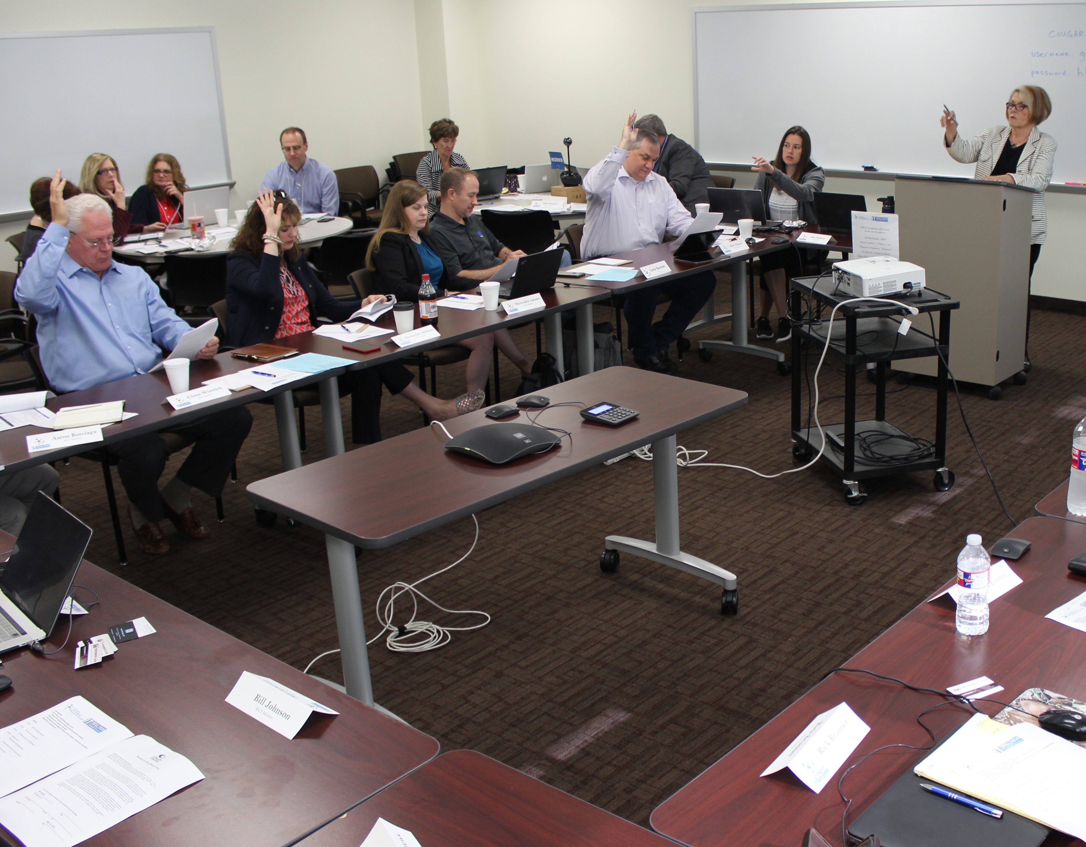
Employer Engagement
The Business and Industry Leadership Team (BILT) offers…
Advisory Committee 2.0 - empowering you to move employer relationships to the next level
A structured, repeatable process that can be used for any technical program
A model that puts employers in a co-leadership role that greatly increases their engagement with your program

Slide 3
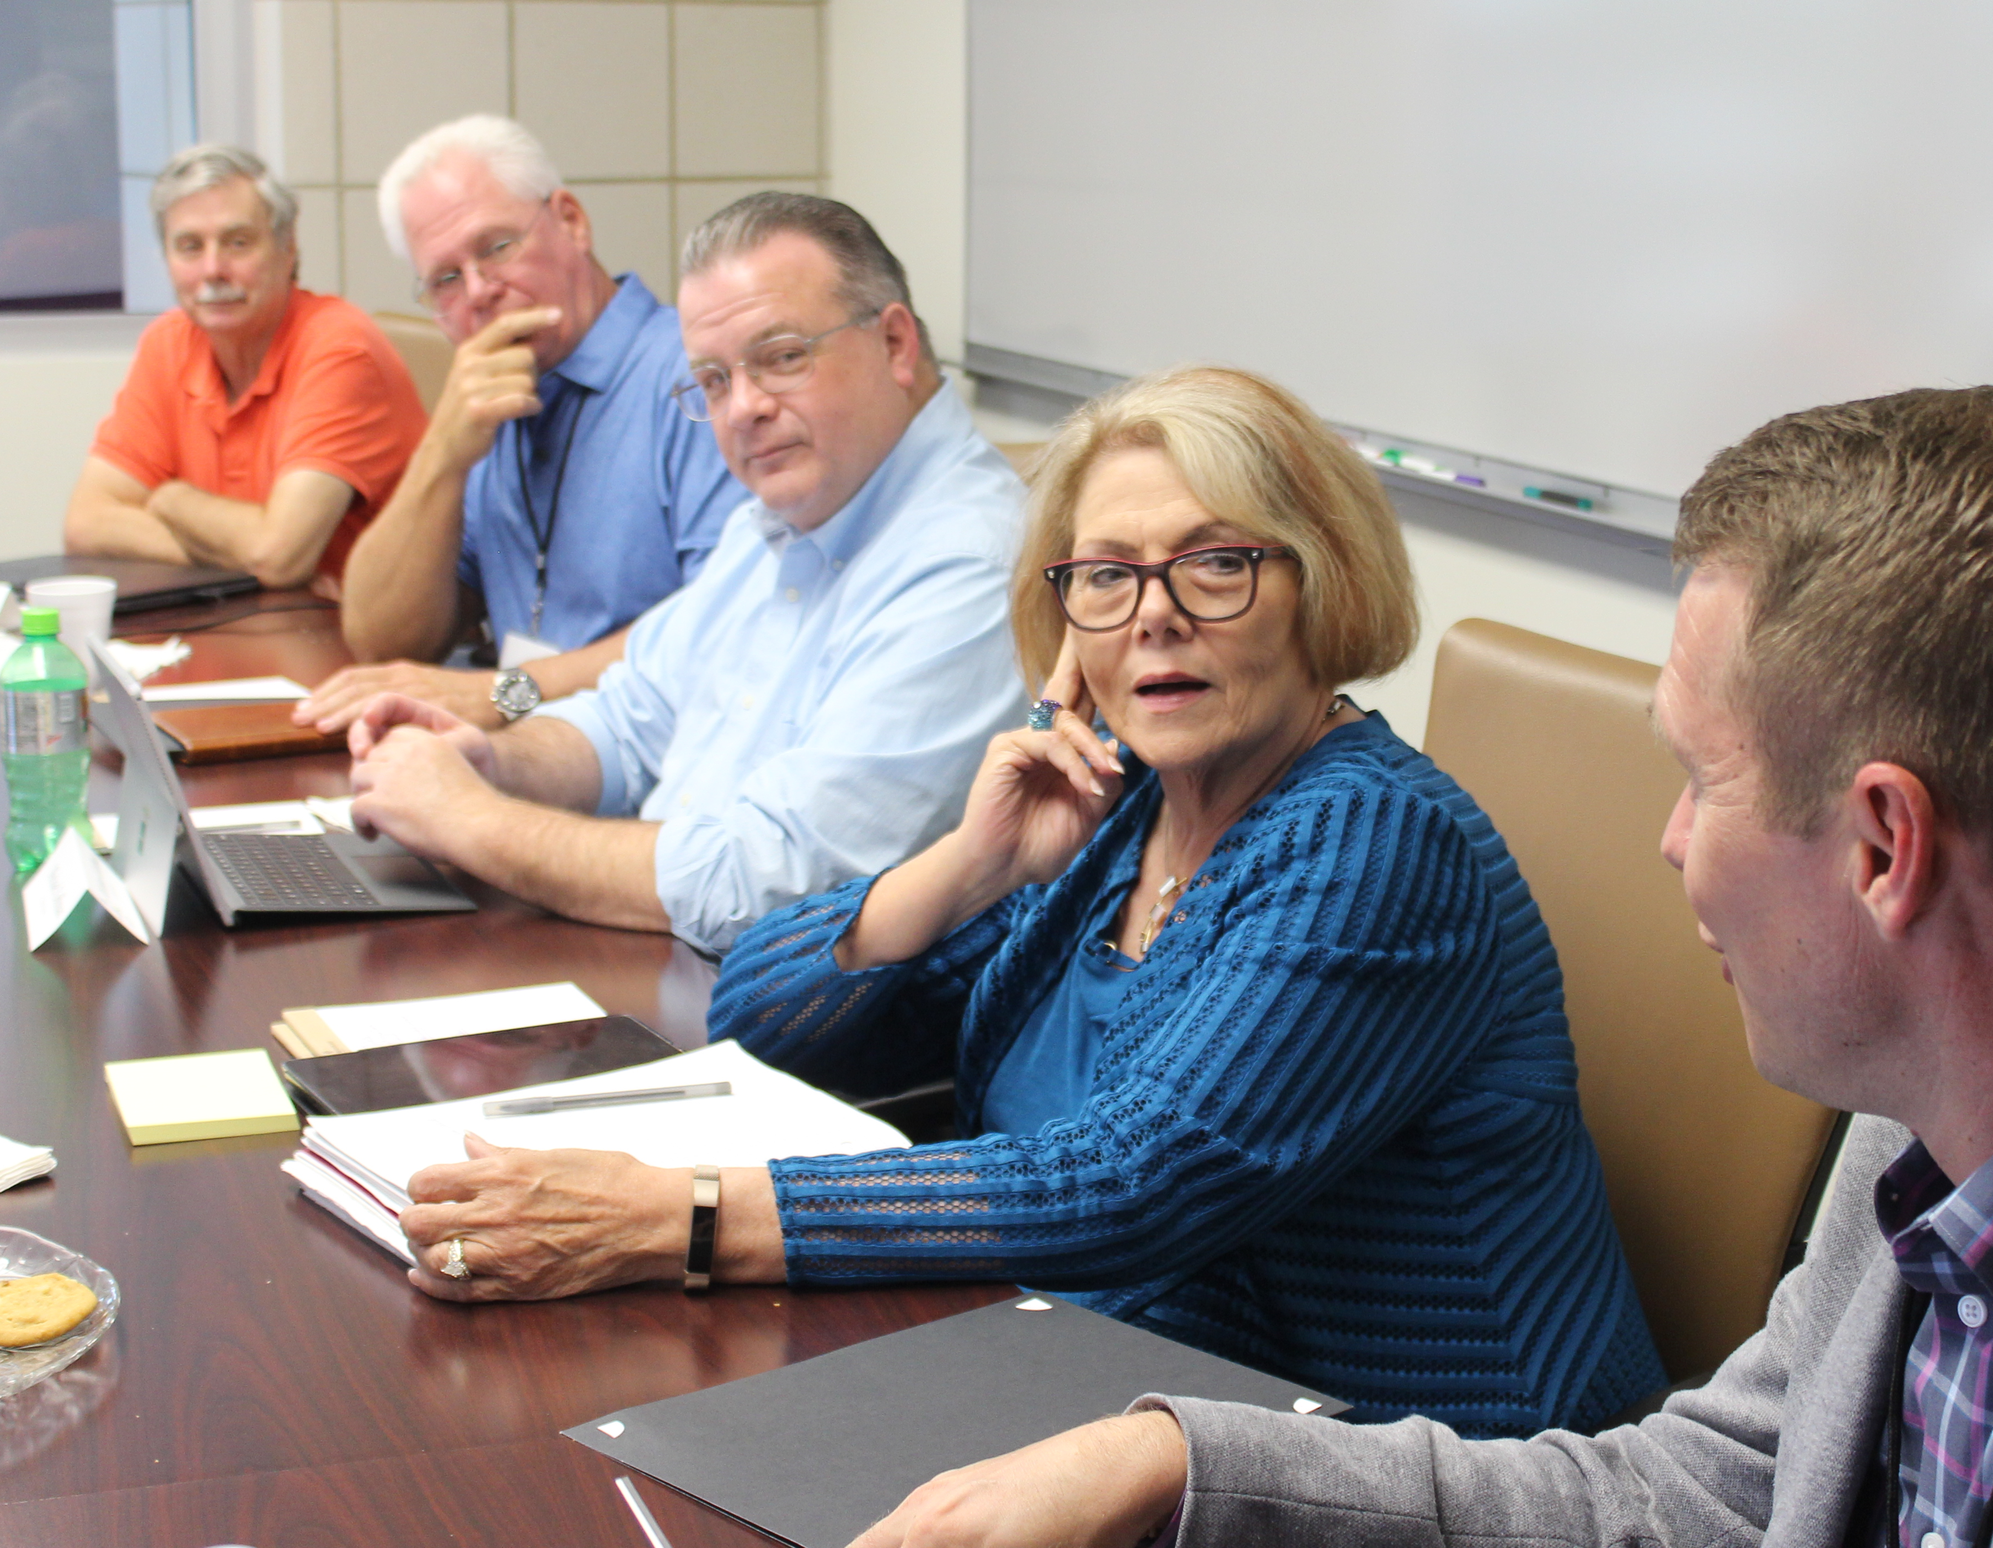
Roots of the BILT Model
National Science Foundation supported National Convergence Technology Center (Collin College in Texas, 2012-2023)
Established BILT model through work with business leaders from across the nation to determine Knowledge, Skills, and Abilities “workforce ready” graduates will need
Model implemented at more than 100 colleges in multiple disciplines.
Dept of Labor and Dept of Education recognize BILT as a leading model for strategic employer engagement

Slide 4
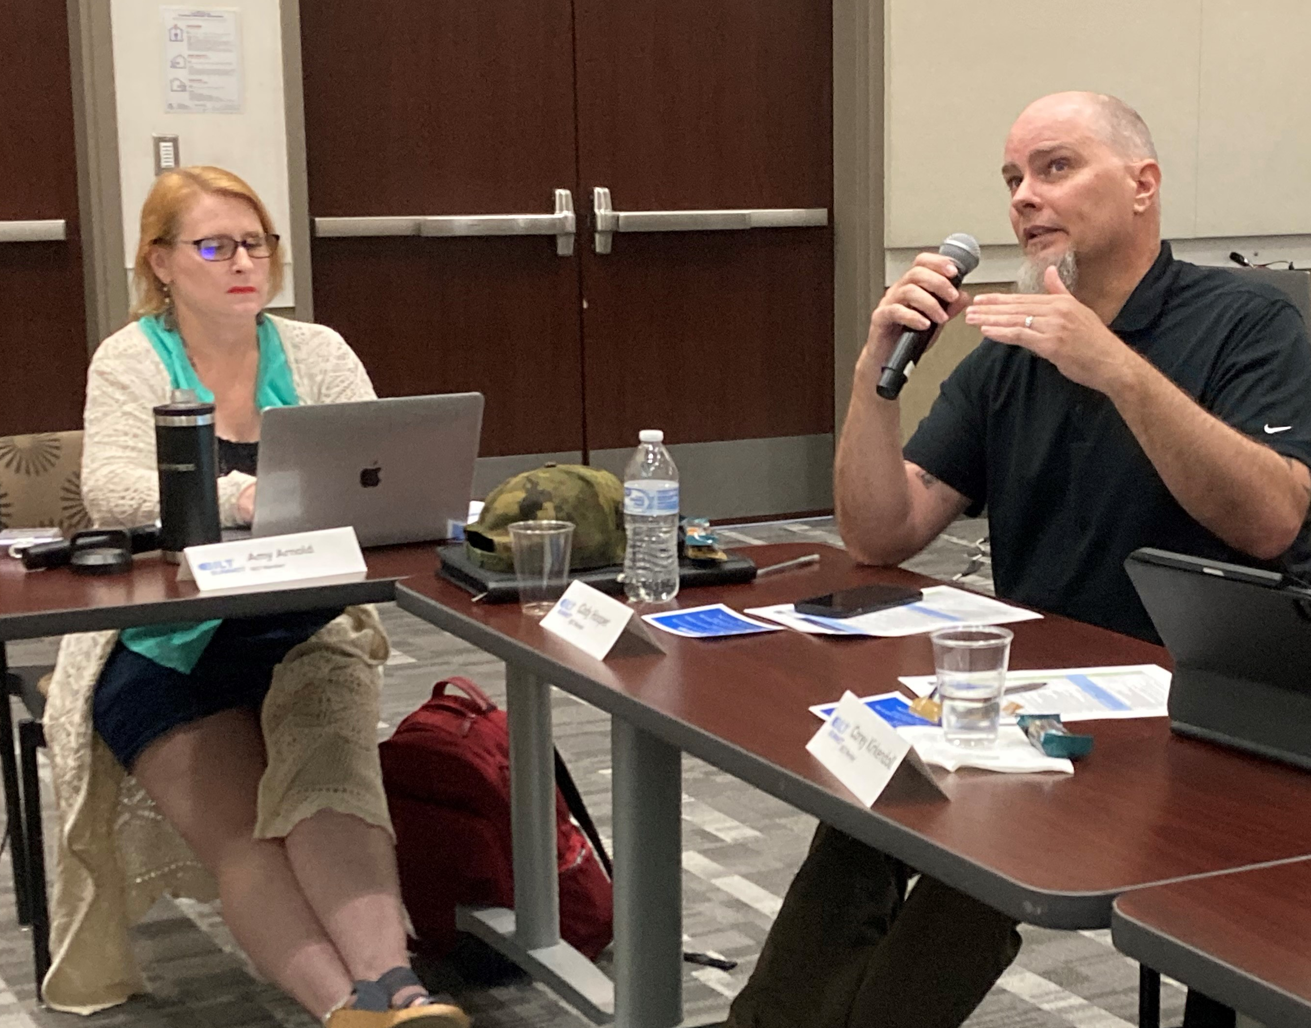
Essential Element: Co-Leadership
Employers report they are more likely to hire graduates from programs for which they have curricular leadership responsibility
Employers report they will assume this role (and more) if:
  Their time is respected
  There is a method for ensuring their input is consistently and seriously considered by faculty members
  They consistently receive feedback on their recommendations

Slide 5


BILT Roles - Business
BILT Roles – Faculty
Co-lead college programs through quarterly meetings
Annually prioritize knowledge and skills they want graduates to have 12-36 months into the future using structured, repeatable voting process and synchronous discussion
Predict labor market demand
Identify industry trends that could impact the program
Attend BILT meetings as active listeners and questioners
Cross reference knowledge and skills to existing curriculum to determine gaps in coverage
Update curriculum to address job skills prioritized by BILT members
Provide BILT members with feedback regarding implementation

Slide 6
Business Advisory Council
BILT
Industry-advised
Industry-led
May meet once or twice a year
Meets quarterly
Occasional “rubber stamp” review of existing program
Granular list of entry-level job skills prioritized and discussed
Faculty may drive meeting agenda
Employers help develop agenda – especially sharing trends
May not be highly invested in long-term success of the program
Feels an ownership in the program and its students
Ignored advice erodes business commitment
Regularly informed on how suggestions are implemented

Slide 7
BILT WIIFM - Business
BILT WIIFM – Faculty
Entry-level employees with “hit-the ground-running” skills (saves $$)
Ability to tangibly give back to the community
Ability to tap eager talent in transitioning to the workforce
Time value realized and appreciated
Delivering relevant, industry sought-after skills
Students more prepared to enter the workforce
Early business engagement exposes students to business perspective (mentoring, internships, business-graded capstone courses)
BILT input can support requests for equipment, software, and professional development

Slide 8
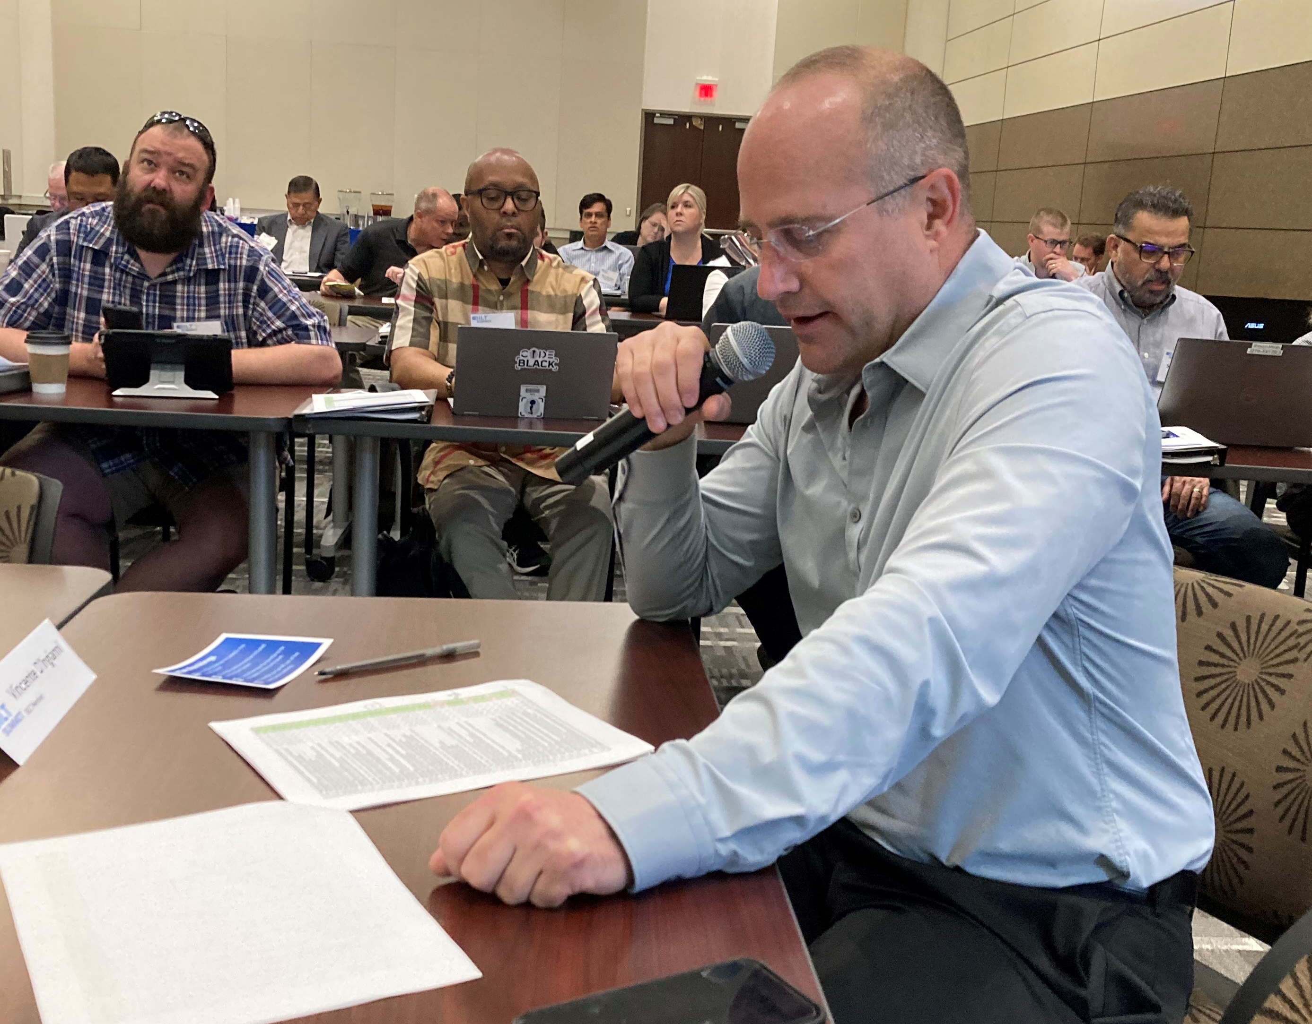
Annual BILT Meeting Cycle
  Cross-discipline mega-BILT meetings for trends discussions held 2-3 times a year (1 hour)
  Single-discipline SME BILT meetings for job skills vote and discussions held once a year (90 minutes)
Building and maintaining a thriving BILT is a high-touch activity with two-way communication.
Emphasis is on growing a pipeline of
right-skilled job candidates

Slide 9
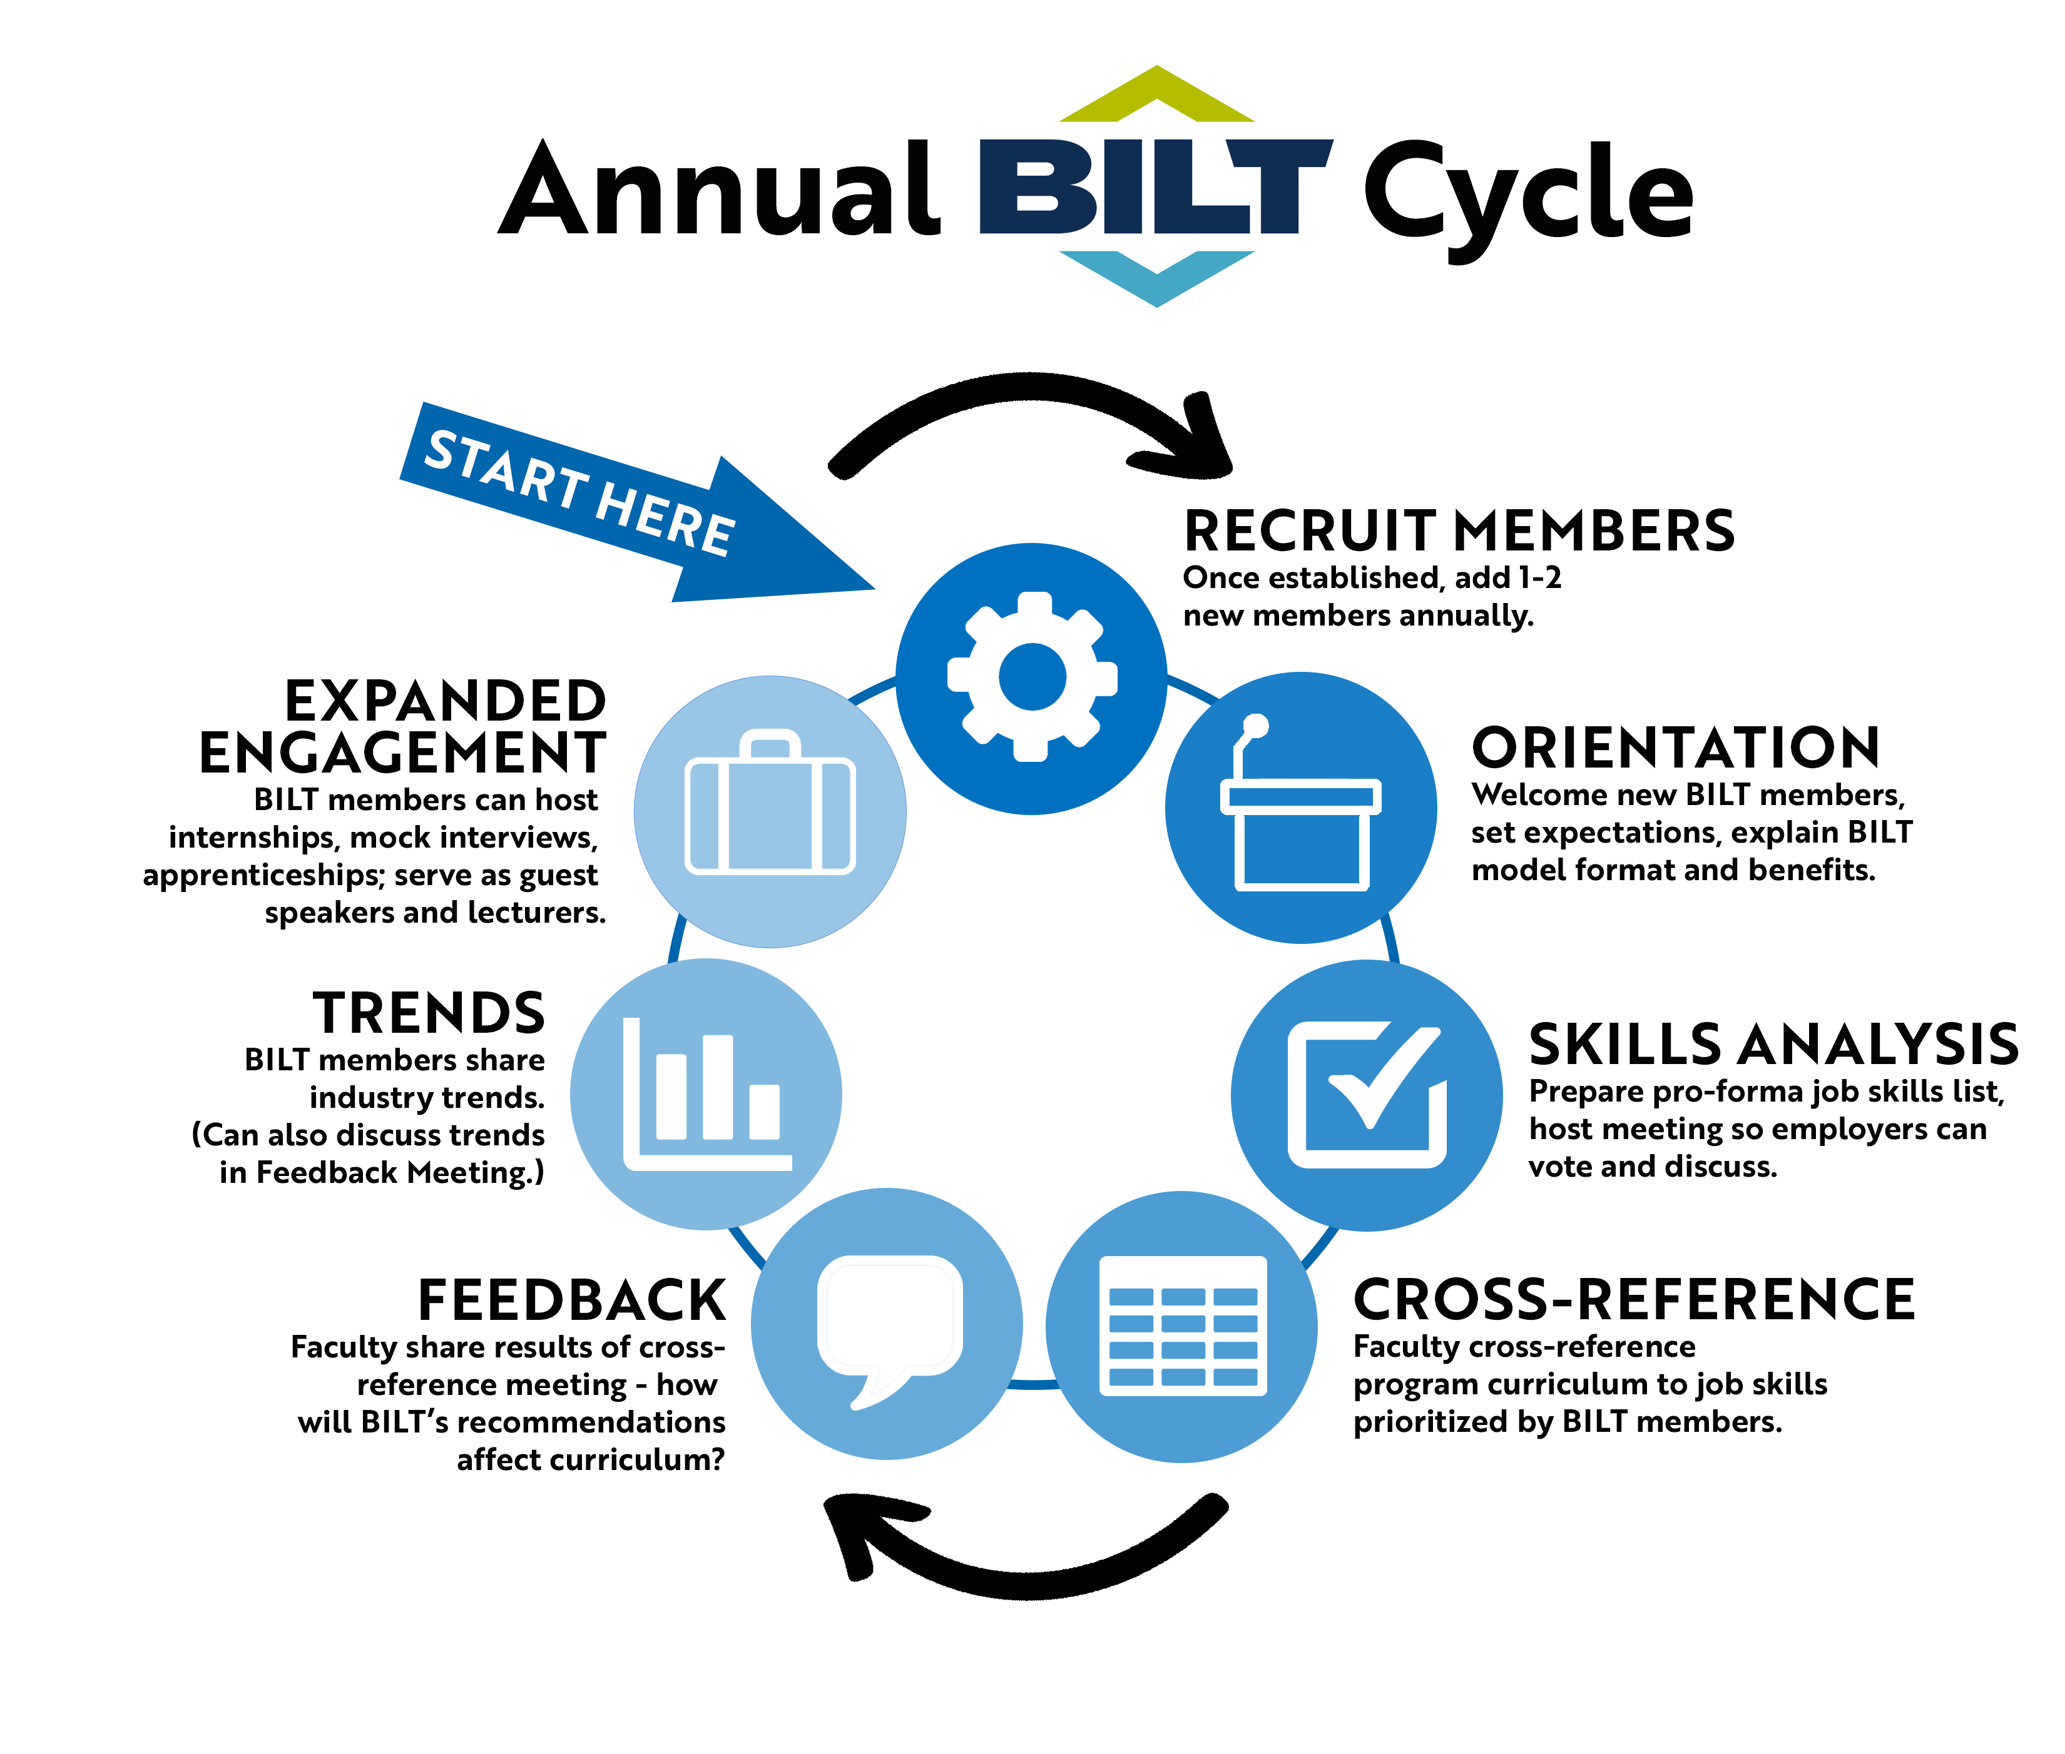

Slide 10

BILT Questions?
Larry McWherter, NITIC P.I.
lmcwherter@cscc.edu
Stephanie Schuler, NITIC Asst Director
sschuler1@cscc.edu
Ann Beheler, NITIC BILT consultant
abeheler@gmail.com
Mark Dempsey, NITIC BILT deliverable lead
mdempsey@collin.edu
nitic@cscc.edu
www.nitic.org

Slide 11


